Slide 1
August 2023

Slide 2
Fun With English
Language of Instruction: English
The children will learn songs, rhymes, story telling, art and painting in an English speaking environment. To improve the effectiveness of the class, children may be reassigned to classes of different age groups depending on their English proficiency. Each class is limited to 15 children.
Code | Age | Day | Time | Fee |  | Class Dates (3 weeks)
E1 | 3 to 6 | Monday to Friday | 9:30a.m.-12:00p.m. (A.M Session) | $4950 (for Think International students only and before the 28th April) | $5450 (for Others) | 10 August (Thur) to 30 August (Wed)
E2 |  |  | 1:00p.m.-3:30p.m. (P.M. Session)
Project fun for
Whole day children
Language of Instruction: English
Our Kindergarten provides a whole day summer program. By using a project approach, children can build up their English communication skills. It also allows them to develop their problem solving skills and be creative. Most importantly, the children enjoy the project approach and have fun learning many skills this summer! (For our UN, Bunnies, Deer, LK & UK students only)
Code | Language | Age | Day | Time | Fee | Class Dates (3 weeks)
W1 | Half day in English + Half day in Putonghua | 3 to 6 | Monday to Friday | 9:30 a.m. - 3:30 p.m. | $8000 (for Think International students only and before 28th April | 10 August (Thur) to 30 August (Wed)
W2 | English (Whole day)

Slide 3
Fun with Science Exploration
Language of Instruction: Cantonese
Joint programme with Hands On Science Outreach (HOSO)
Students with attendance of 80% or above will receive certificate
Our selected science courses are aimed to broaden the horizons and stimulate “science in your life” awareness to the children.
The children will learn through fun and active involvement in experiments, games and projects. There are hands-on materials used in every class that will go home with children.
Theme : Hot Stuff (Solar energy)
Why do shadows made by the sun move? Learn about water cycle. Which material heats up most quickly? Split light with bubbles and special rainbow glasses. Surprises await when using ultraviolet detecting beads on sunny day.
Code | Age | Day | Time | Fee | Class Dates ( 4 lessons)
S1 | 3 to 6 | Monday | 3:30pm-4:30pm | $800 | 7, 14, 21, 28 Aug

Slide 4
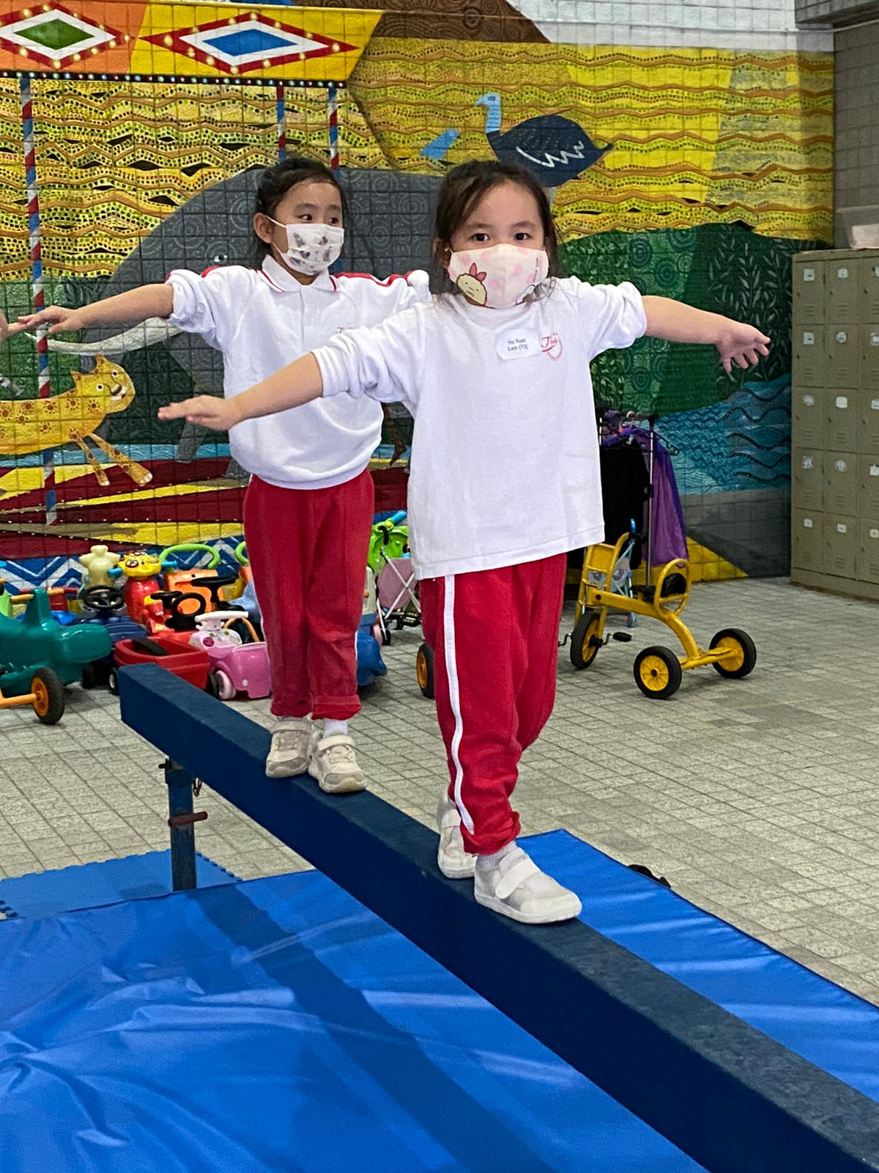
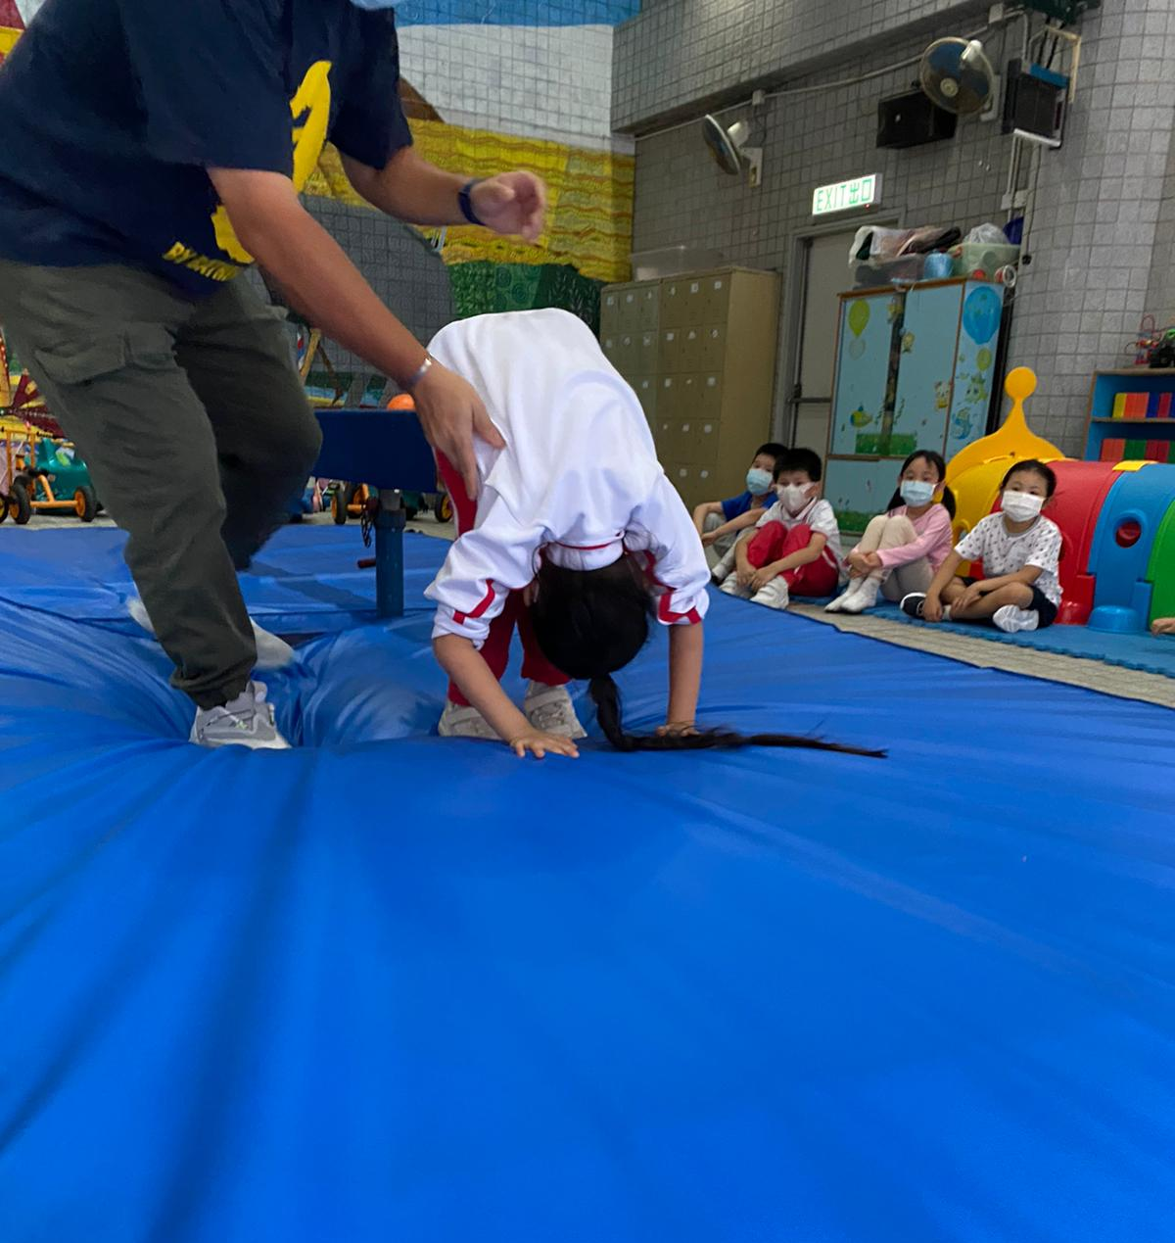
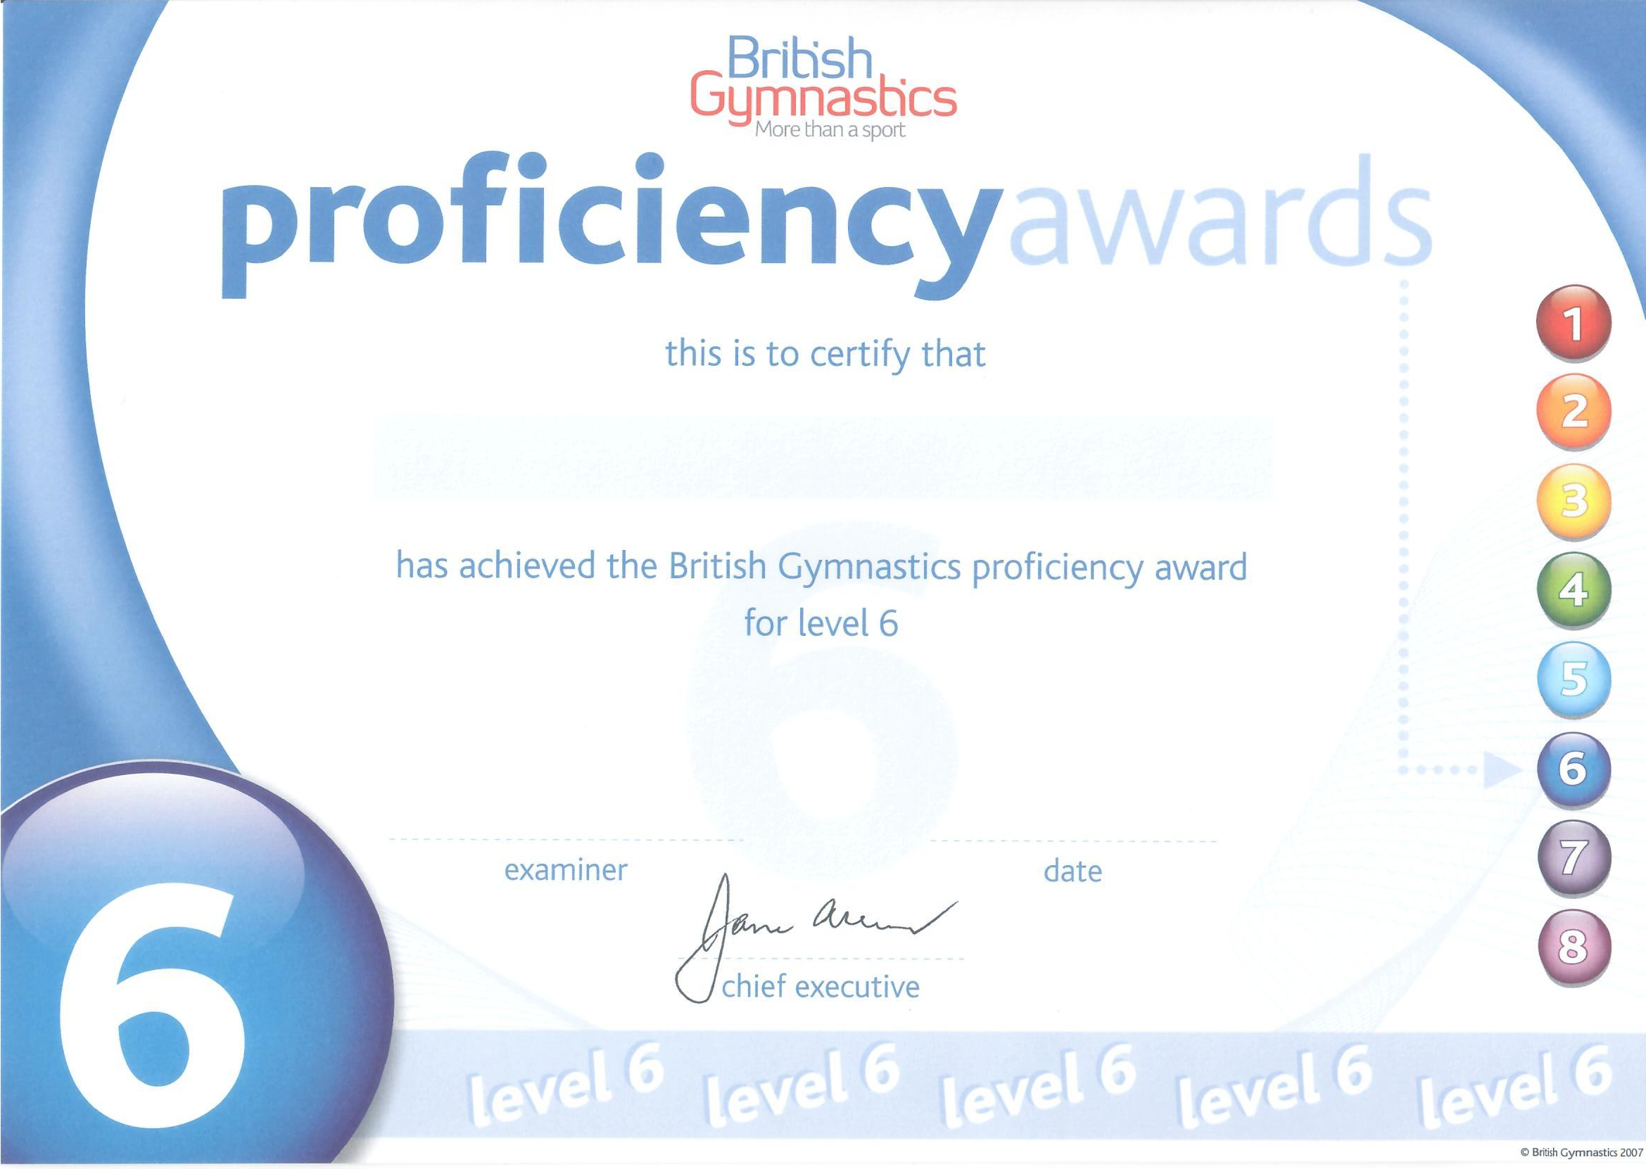
Fun with Gymnastics
Language of Instruction: Cantonese
This gymnastic program, which is offered throughout the year, helps to tone up the muscles of the children and make them healthier, fitter and happier through a series of planned physical activities. Gymnastics activities can strengthen children’s motor skills, hand-eye coordination, physical ability as well as foster their self-confidence and self-discipline.
Language of Instruction: English
Code | Level | Age | Day | Time | Fee | Class Dates (4 lessons) -Tues Class Dates (4 lessons) – Sat
G1 | Beginners | Up to 3 | Tues | 3:30pm to 4:15pm | $800 | Tues : 8,15,22,29 Aug & Sat : 12,19,26 Aug 2 Sept
G4 |  |  | Sat | 10:00am to 10:45 am | $900
 |  |  | Sat | 10:00am to 10:45 am | $800
G2 | Level 1 | 3 to 5 | Tues | 3:30pm to 4:30pm | $840
 |  |  | Sat | 10:00 am to 11:00 am | $840
G5 |  |  | Sat | 10:00 am to 11:00 am | $950
G3 | Level 2 | 5 to 12 | Tues | 3:30pm to 4:45pm | $880
G6 |  |  | Sat | 10:45am to 12:00 noon | $800
Project fun for
Whole day children
Last year the English project summer program was a success. Parents loved the idea of having a fun whole day project class for the children. This summer the school is offering whole day project classes and children who are currently attending whole day school will be given the priority to register into this program. (For UN, Bunnies, Deer, LK & UK students only)
Code | Language | Age | Day | Time | Fee | Class Dates (4 weeks)
W1 | Half day in English + Half day in Putonghua | 3 to 6 | Monday to Friday | 9:30a.m.-3:30p.m. (Whole day) | $11000 (for Think International students only and before 23rd April | July 22 (Thur) to August 18 (Wed)

Slide 5
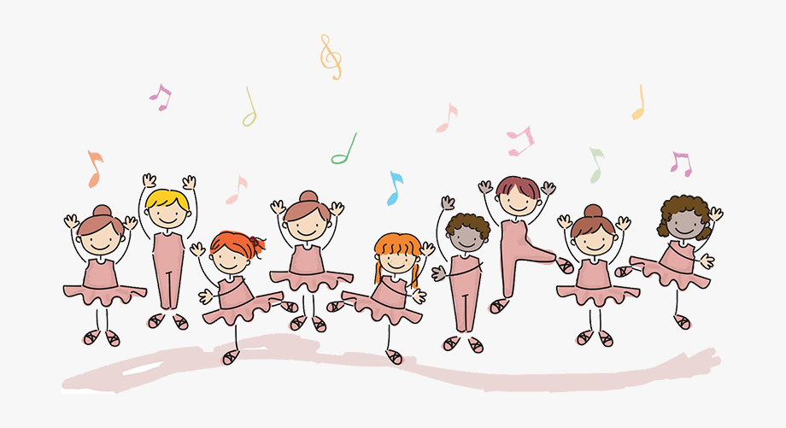
Fun with Ballet
Language of Instruction: Cantonese
This class is designed for children who are interested in ballet and musical movements. The curriculum follows that of the Royal Academy of dancing from the United Kingdom. As the children progress through the course, they will be nominated to take the examinations at the Royal Academy of Dancing.
Code | Age | Day | Time | Fee | Class Dates ( 4 lessons)
B1 | 3 to 6 yrs old | Thursday | 3:30pm-4:15pm | $800 | 10, 17, 24, 31 Aug
Fun with K-Pop and Jazz Dancing
Language of Instruction: Cantonese
A new and fun way to promote physical fitness, improve mind and body coordination to children, through popular Korean music. The children will be introduced to basic steps and techniques in Jazz. The curriculum follows that of the A.T.O.D.
Code | Age | Day | Time | Fee | Class Dates ( 4 lessons)
D1 | 3 to 6 yrs old | Thursday | 4:15pm-5:00pm | $800 | 10, 17, 24, 31 Aug

Slide 6
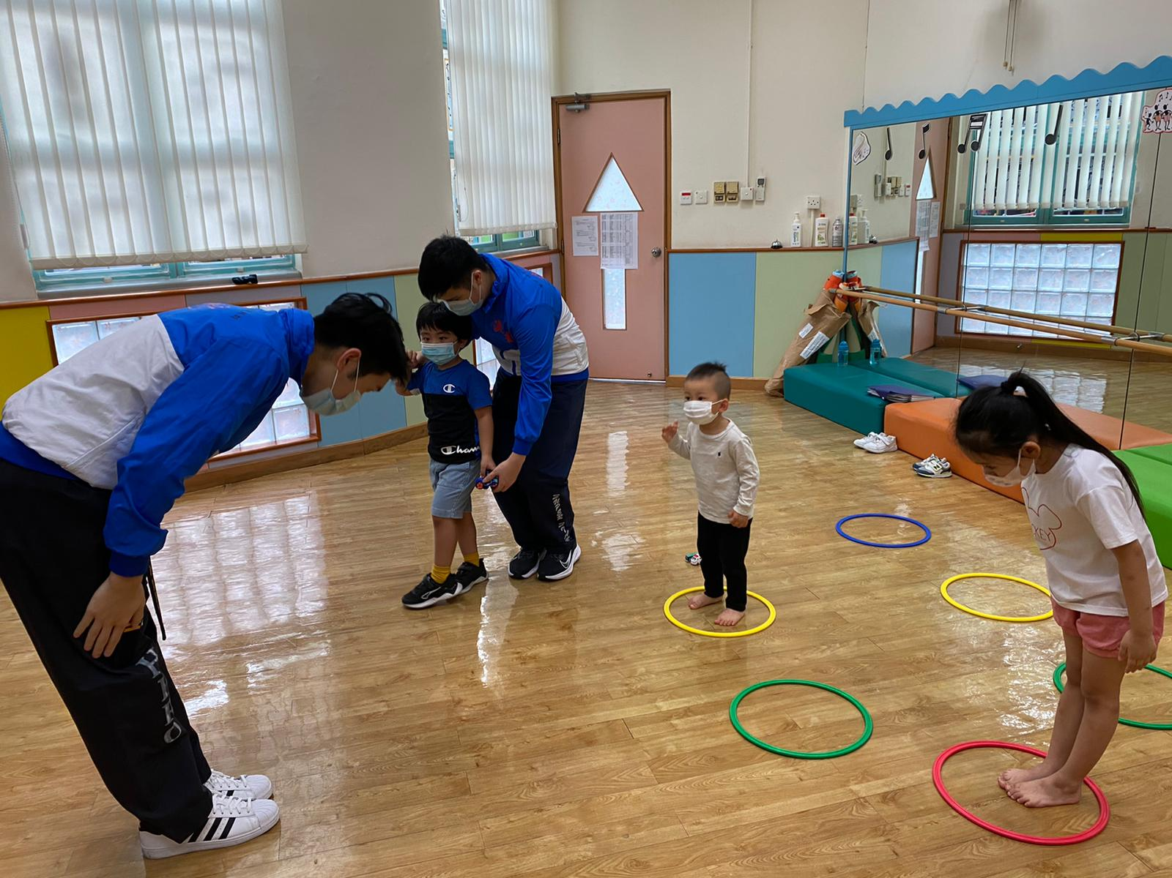
Fun with Taekwondo
Language of Instruction:
Cantonese supplemented with Korean
This Taekwondo programme aims at enriching children with the spirit of Taekwondo and to providing a strong foundation for character building. Children are encouraged to progress through the belt system: white, yellow, green, blue, red and black so that they can mature physically and spiritually. Examinations will be organized for the children around once per year (subject to the child’s progress). This programme is well-structured and well-recognized, so that the children can bridge up to other Taekwondo classes in the future even when they graduate from our Kindergarten.
Code | Age (yrs) | Day | Time | Fee | Class Dates (4 lessons)
T1 | 2 to 6 | Friday | 3:30pm-4:30pm | $880 | 11, 18, 25, Aug, 1 Sept
Fun with Chinese Writing
Language of Instruction: Cantonese
This course is to help the Upper Nursery and Lower Kindergarten children with their Chinese penmanship in their transition to the LK class. Children will be introduced to pencil control and writing basic Chinese characters. For children promoting to UK, we will introduce sentence formation and journal writing skills. (For Think students only)
Code | Age | Day | Time | Fee | Class Dates (6 lessons)
C1 | 3 to 5 | Wed & Fri | 3:30pm-4:15p.m. | $1200 | 16, 18, 23, 25, 30 Aug, 1 Sept

Slide 7
Think International Educational Services Limited
Summer Fun 2023
Enrolment Form (August) -Laguna city
Please submit the filled Enrolment Form & crossed cheque payable to “Think International Kindergarten” to our school office in person. We will issue an official receipt once the enrolment is confirmed. (No Cash please) (Please ☑ )
Name of Child : |  |  | (Eng) |  |  |  | (Chi)
Birthday (D/M/Y): |  |  |  |  |  |  | Sex:
Parent’s Tel. No.: |  |  | (Mobile) |  |  |  | (Home)
Home Address:
Current THINK student ?
 | □ | Yes |  | Class Attending : LN__ /UN___/LK___/UK___
 | □ | No |  | School Attending: ___________________________________
Cheque Number : ___________________ Amount : $__________________
Programmes to enroll (Please ☑ )
Fun with English (Mon to Fri) |  |  | E1 A.M (LN & UN) E1 A.M. (LK & UK) |  | E2 P.M. (LN & UN) E2 P.M. (LK & UK) | E2 P.M. (LN & UN) E2 P.M. (LK & UK) |  | E2 P.M. (LN & UN) E2 P.M. (LK & UK) | $6300 for Think students | $6300 for Think students | $4950 for Think students
 |  |  |  |  |  |  |  |  | $6800 for Others | $6800 for Others | $5450 for Others
Project Fun for Whole day children (Mon to Fri) |  |  | □ W1 $8000 (English + Putonghua) (For UN, LK, UK student only)
 |  |  | □ W2 $8000 (English only) (For UN, LK, UK student only)
My child needs school bus service for E1, E2, W1 or W2 and current THINK students only. Name of Route Station : _______________________ □ One-Way to school / □ One-way from School / □ Round trip *** The Bus fee will remain the same price as currently. *** The school will try to schedule a possible route for your area and we will contact you individually. *** We apologize for any inconvenience if we can’t schedule your preferred area. ******************************************************************************
Fun with Science Exploration (Monday) |  |  |  |  |  |  |  | □ S1 $800
Fun with Chinese Writing (Wednesday & Friday) |  |  |  |  |  |  |  | □ C1 $1200
Fun with Ballet (Thursday) |  |  |  |  |  |  |  | □ B1 $800
Fun with K-pop & Jazz dance (Thursday) |  |  |  |  |  |  |  | □ D1 $800
Fun with Gymnastics (Tuesday) |  |  |  |  |  |  |  | □ G1 $800 | □ G2 $1140 | □ G2 $840 |  | □ G3 $880
Fun with Gymnastics (Saturday) |  |  |  |  |  |  |  | □ G4 $800 | □ G5 $950 | □ G5 $840 |  | □ G6 $880
Fun with Taekwondo (Friday) |  |  |  |  |  |  |  | □ T1 $880
(Is your child allergic to any materials? No / Yes _______________________________________)

Slide 8
Think International Educational Services Limited
Summer Fun 2023
Enrolment Form (August) -Laguna city
Enrolment and Programme Regulations
All fees paid are non-refundable, and no make up class for absentee.
For when Typhoon No. 3 and Red Rainstorms or higher are hoisted, the lesson will be cancelled without compensation.
If the Red / Black rainstorm signal is in effect while the kindergarten is in session, children will continue their session at school
Children that have fever or not feeling well are encouraged to stay home and rest.
G/F, Phase 3, Laguna City, 99 Cha Kwo Ling Road, Kowloon.
Tel: 27274747 www.think.edu.hk

